Slide 1

Sign Language Recognition
SCALABLE Machine Learning
Presented by:
Hira Mahmood (HM26732)
Shaharyar Mahmood (SM78856)
Danish Mahmood (DM55444)

Slide 2
Content
Introduction
Problem statement
Objective
Dataset description
Software used
Project modules
Result
Challenges & recommendations

Slide 3
Introduction
The world is hardly live without communication, no matter whether it is in the form of texture, voice or visual expression.
The communication among the deaf and hard-of hearing people is carried by text and visual expressions.
Gestural communication is always in the scope of confidential and secure communication.

Slide 4
Problem Statement
Understanding the exact context of symbolic expressions of hard of hearing people is the challenging job in real life until unless it is properly specified.

Slide 5
Objective
Communication is always having a great impact in and how every domain and how it is considered the meaning of the thoughts and expressions that attract the researchers to bridge this gap for every living being.
The objective of this project is to identify the symbolic expression through images so that the communication gap between a normal and hearing impaired person can be easily bridged.

Slide 6
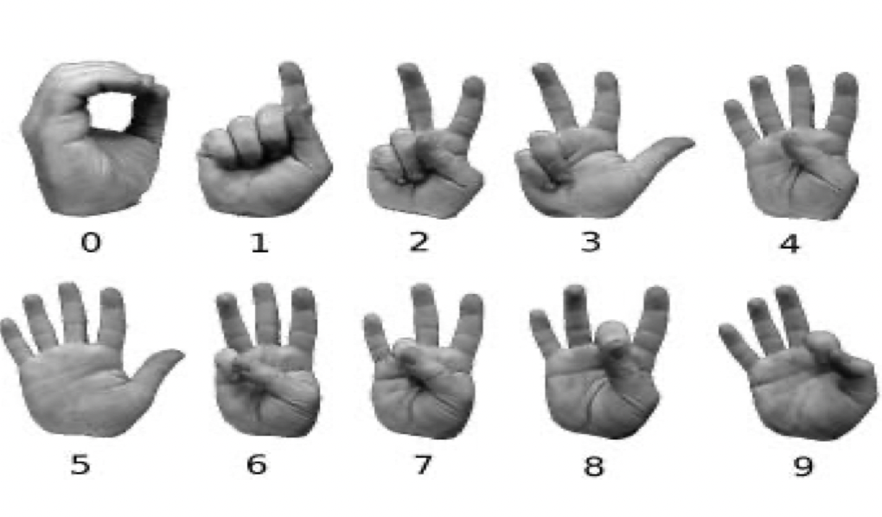
DataSET Description
We analyze 15,000 images of sign images of sign language digits. which have a spread of 10 class
for each number sign the training set consisting of 1,465 images and test dataset consisting of 35 unique images.

Slide 7
Software Used
Software & libraries for the sign language project used are:
Python (3.7.4)
IDE (Jupyter)
Numpy (version 1.16.5)
cv2 (openCV) (version 3.4.2)
Keras (version 2.3.1)
Tensor-flow (as keras uses tensorflow in backend and for image preprocessing) (version 2.0.0)

Slide 8
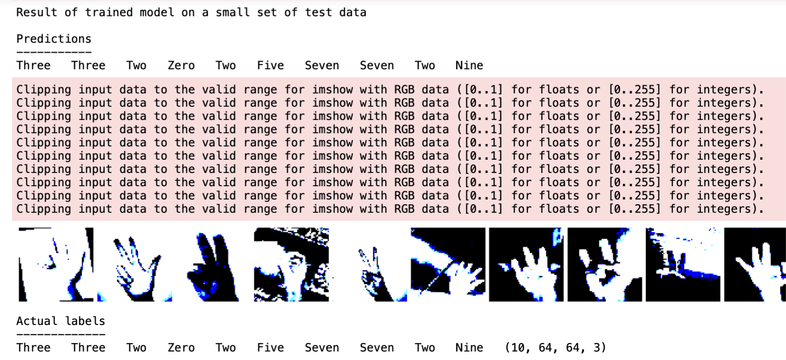
Project Modules
Creating the dataset
Training a CNN on the dataset
1. Data Preparation
2. Data Augmentation
3. loading and preprocessing
4. crafting the CNn architecture
5. Guided by optimization algorithms
6. navigation the training process
7. ensuring robustness with validation
8. Safeguarding Knowledge
Predicting the data

Slide 9
Results
Sign Language Recognition

Slide 10
challenges & recommendations
It's important to have a large and diverse dataset for training the CNN model, with a sufficient number of samples for each class.
Tuning hyper-parameters like learning rate, batch size, and number of epochs can also affect the model's performance.
Depending on the use case, it might be helpful to incorporate other modalities like audio or text to improve the recognition accuracy.
Insufficient data or poor quality data can negatively impact the model's accuracy.
Limitations in the camera's resolution or frame rate may affect the system's ability to detect and recognize signs accurately.
Challenges in interpreting sign language gestures that may be similar in appearance but have different meanings, making it difficult for the model to differentiate between them.

Slide 11
